Slide 1
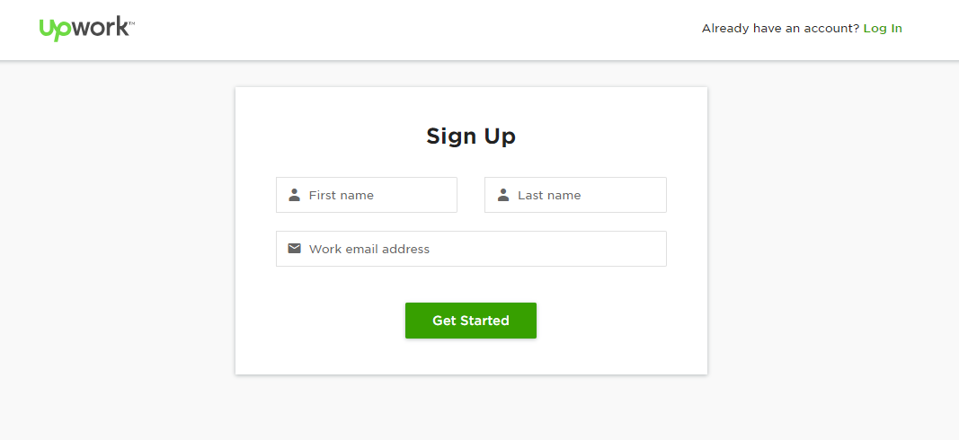
Registration Step 1

Slide 2
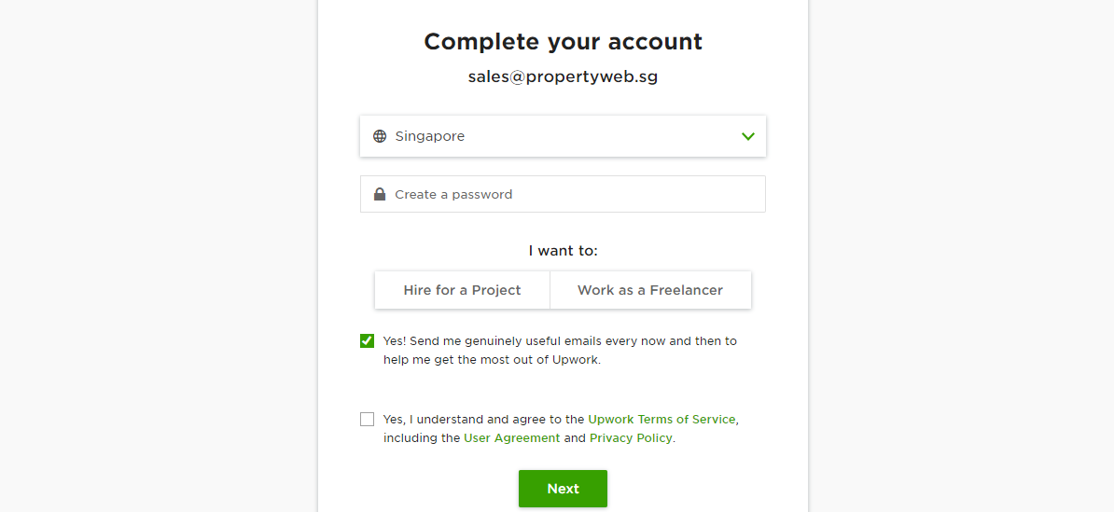
Registration Step 2

Slide 3
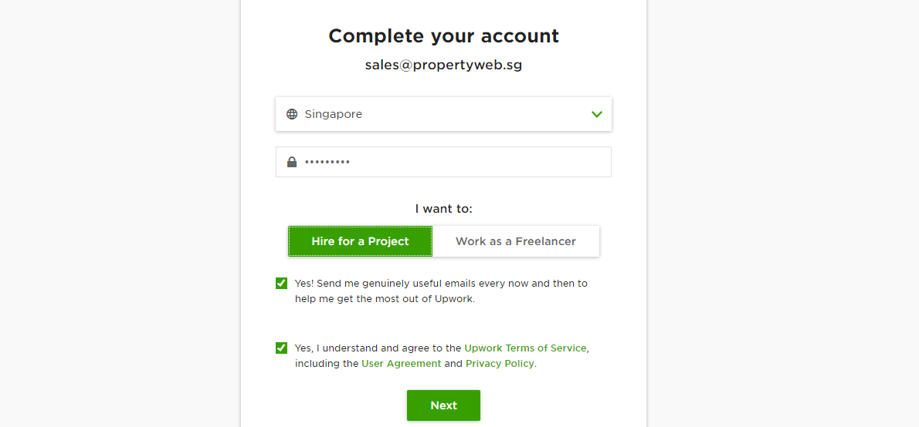
Client Account

Slide 4
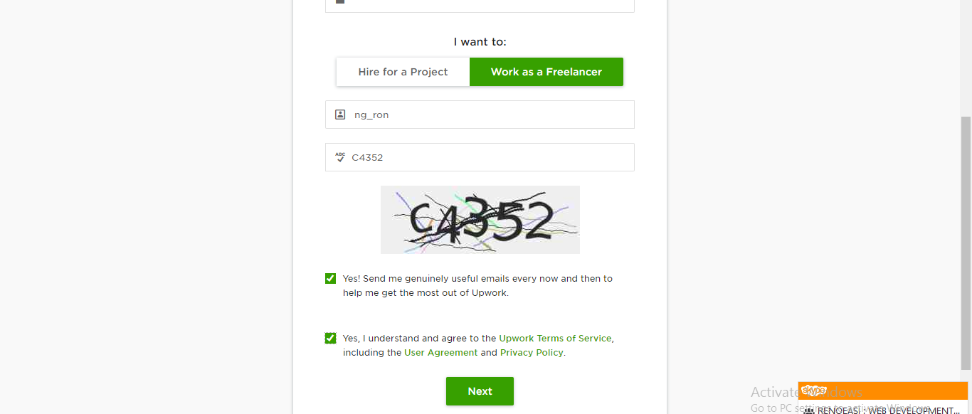
Freelancer Account

Slide 5
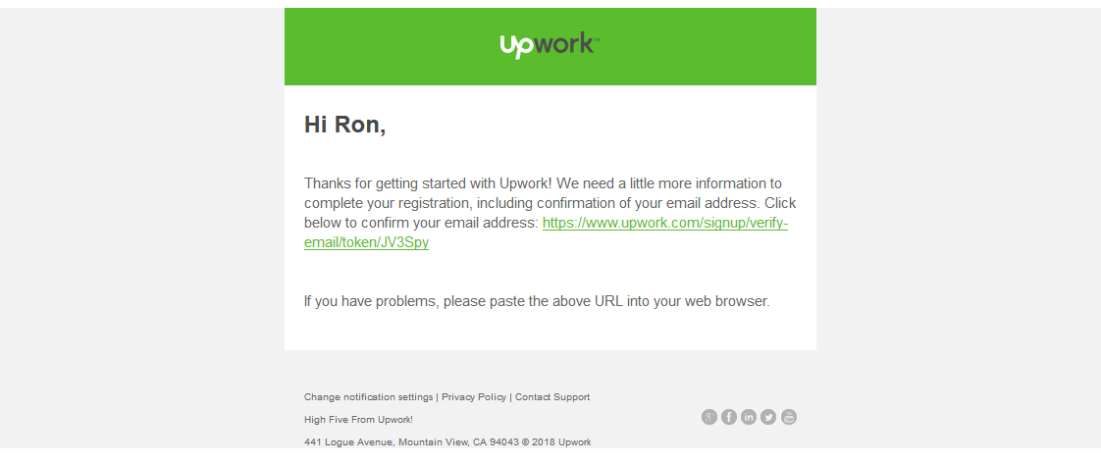
Freelancer Confirmation Email

Slide 6
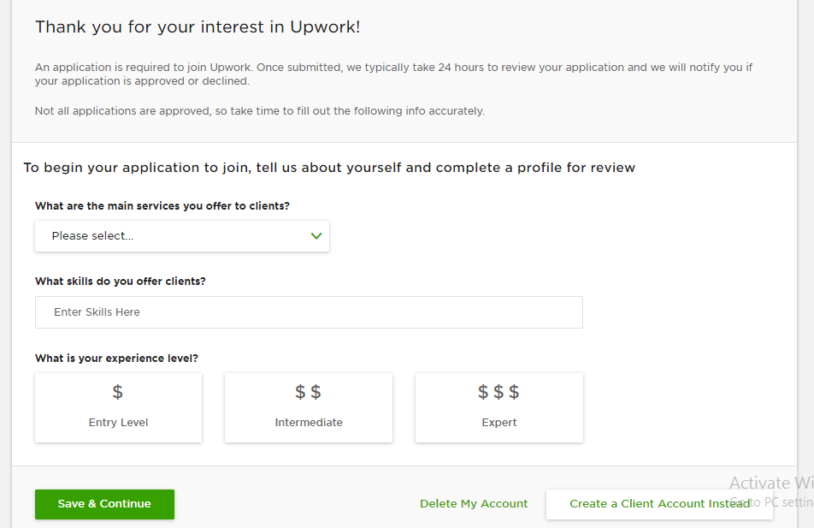
Freelancer Confirmation links bring us to this

Slide 7
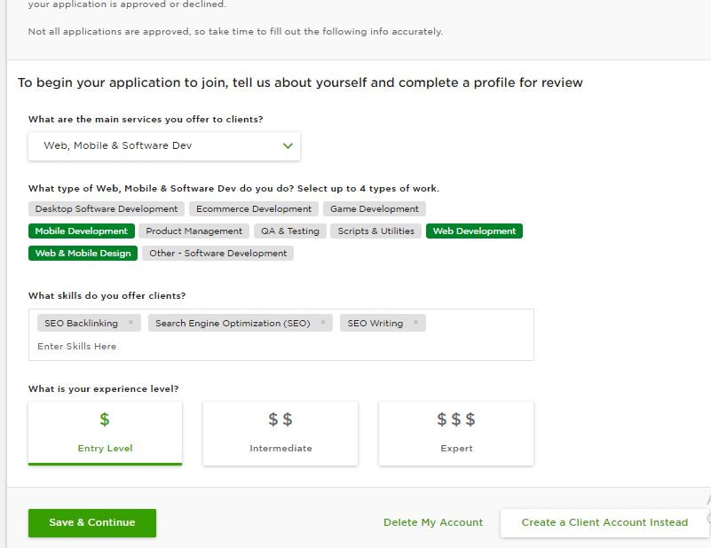

Slide 8
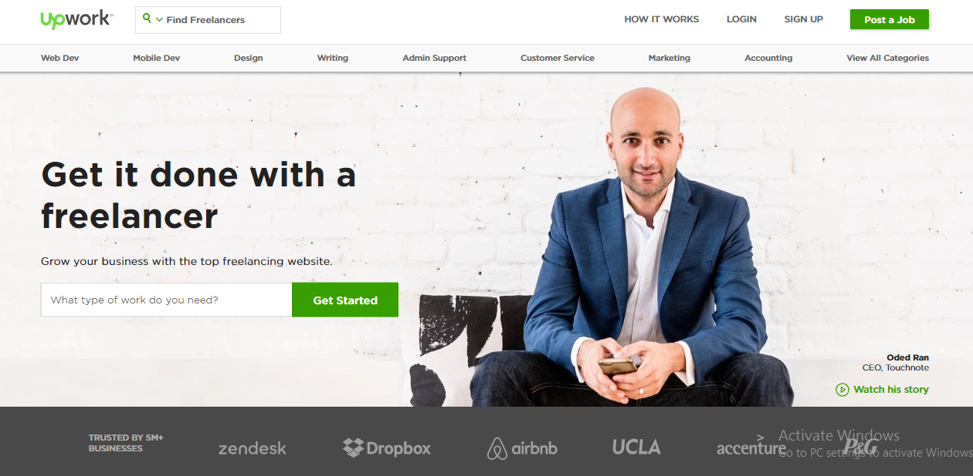

Slide 9
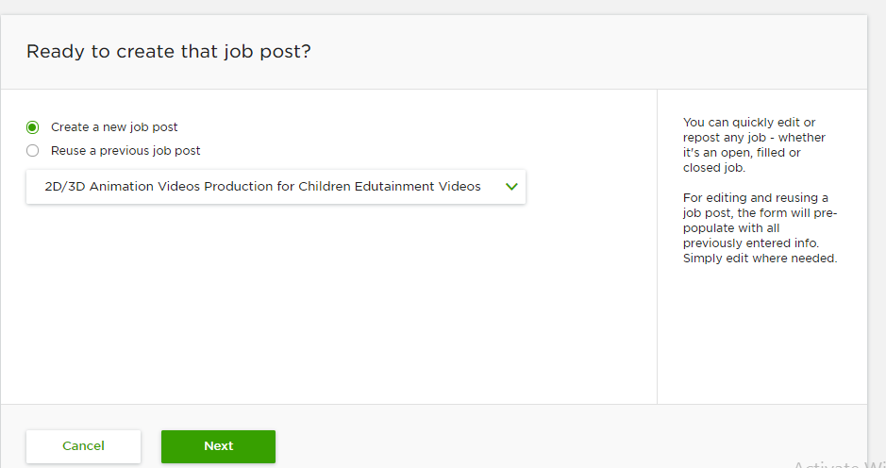
Client - Post a Job

Slide 10
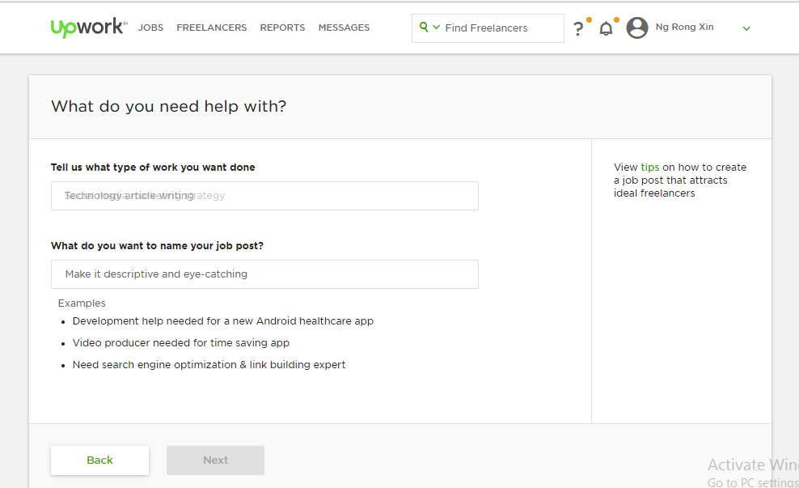
Client - Post a Job

Slide 11
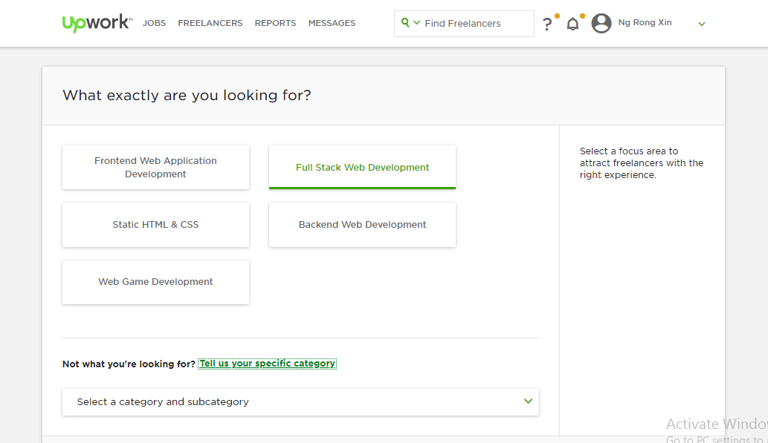
Client - Post a Job

Slide 12
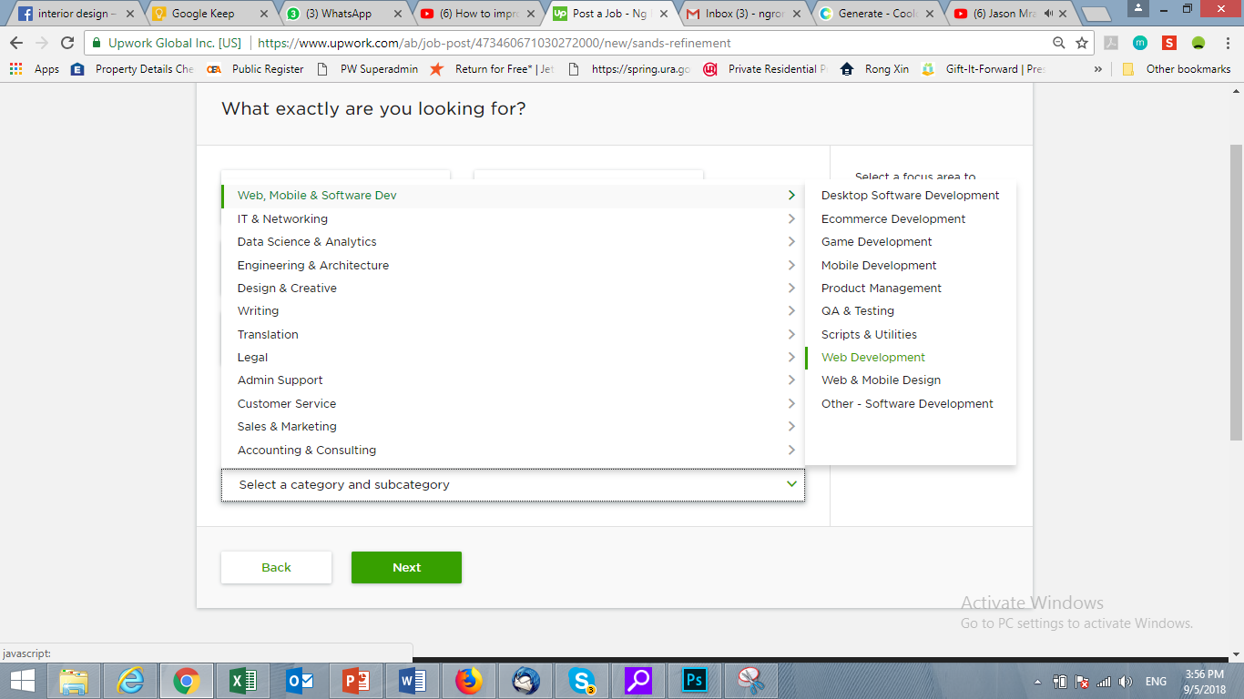
Client - Post a Job

Slide 13
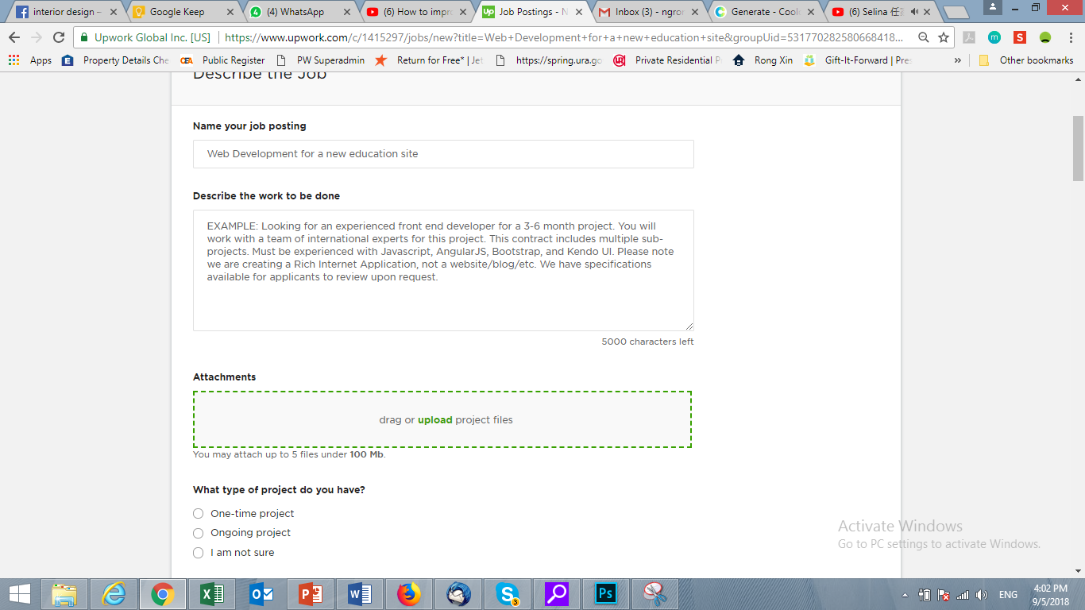
Client - Post a Job

Slide 14
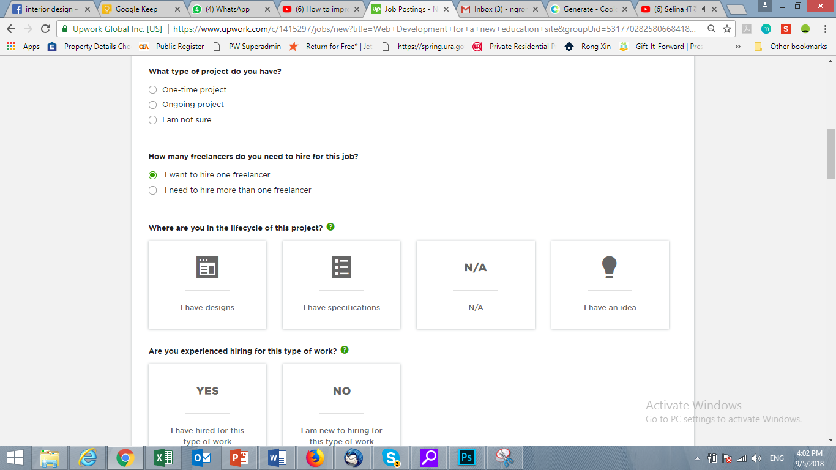
Client - Post a Job

Slide 15
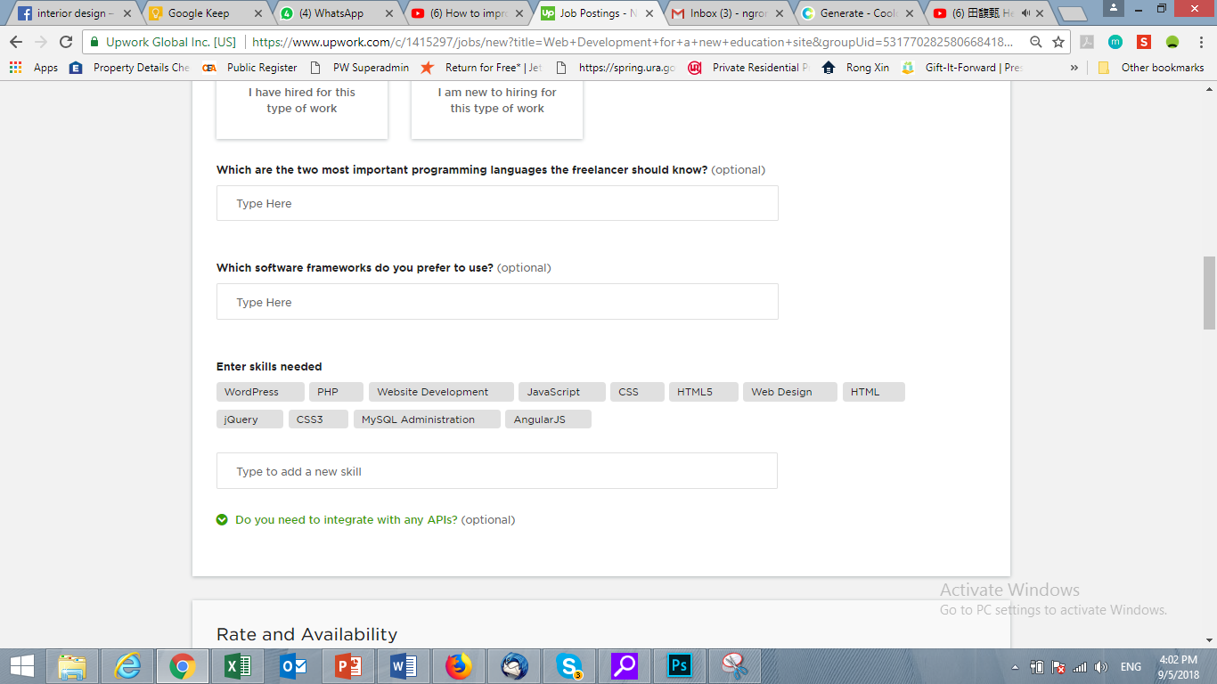
Client - Post a Job
Suggest skills based on categories

Slide 16
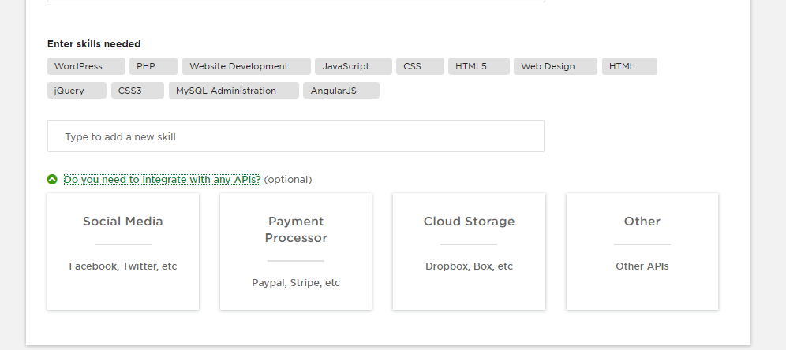
Client - Post a Job

Slide 17
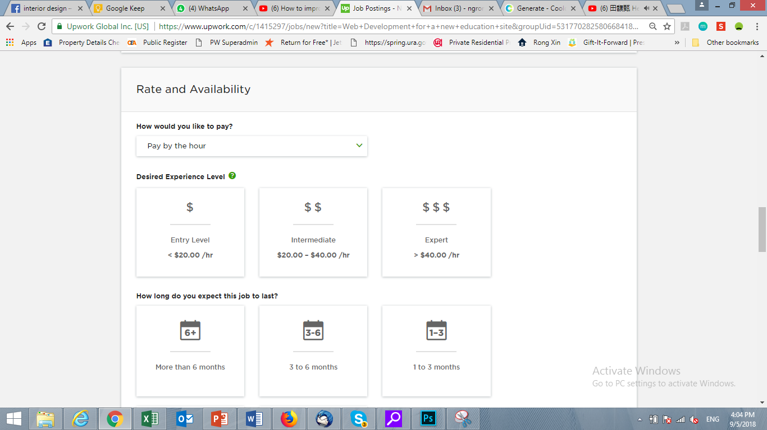
Client - Post a Job

Slide 18
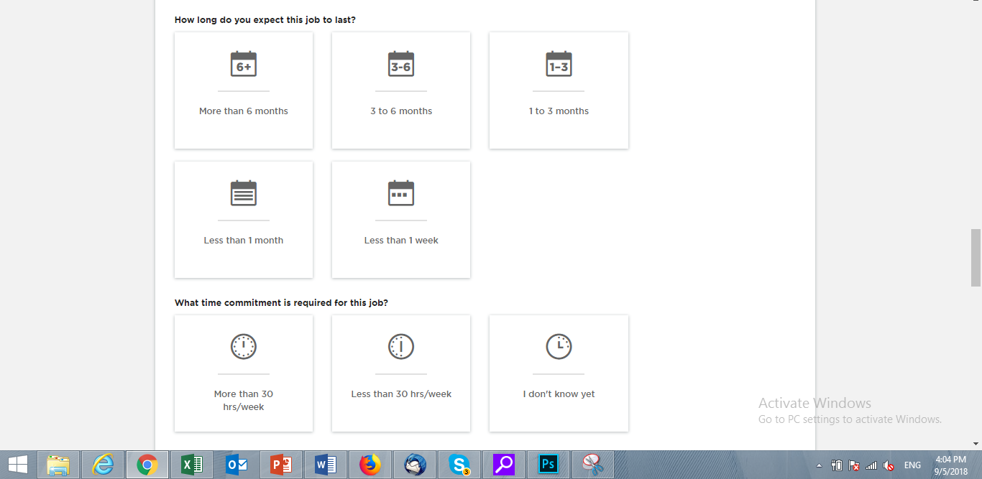
Client - Post a Job

Slide 19
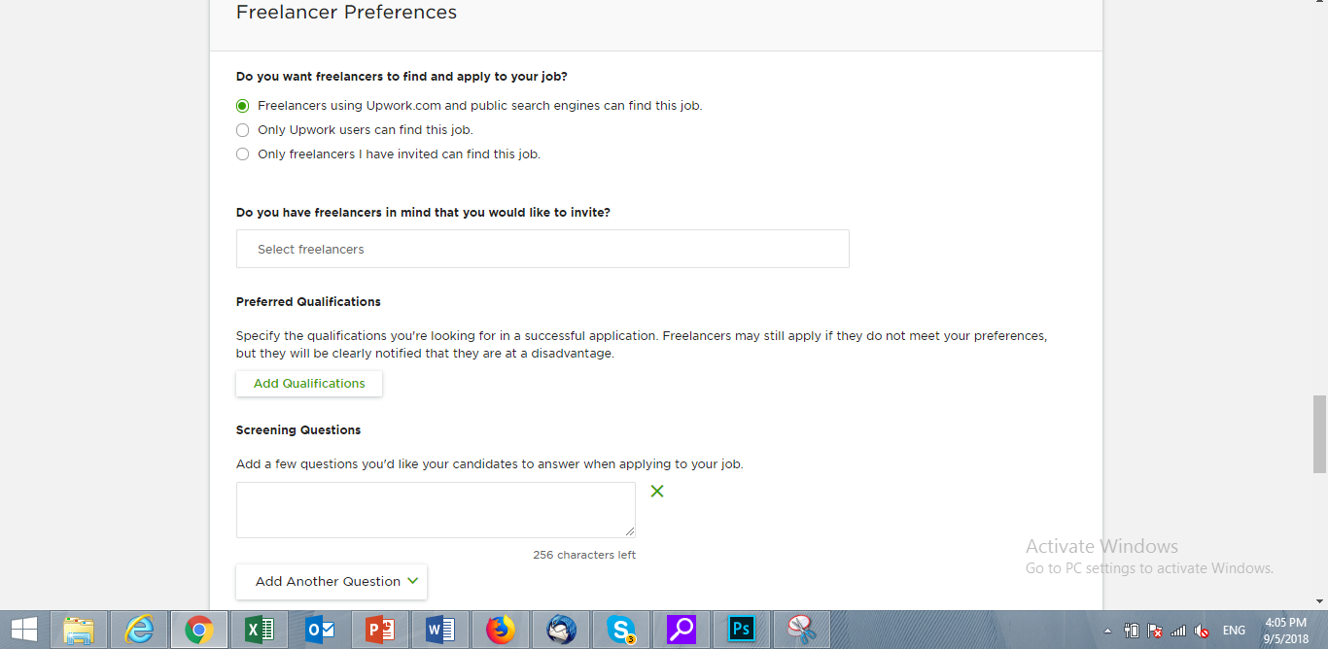
Client - Post a Job

Slide 20
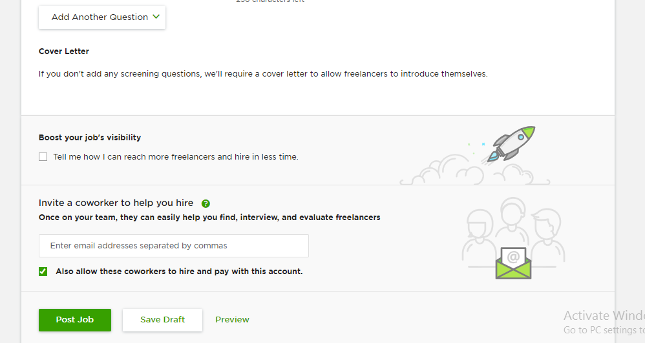
Client - Post a Job
Next

Slide 21
Client - Post a Job
Go on to “Next” page from here.
Add in the parts we wrote for you here under Freelancer preference.
Title: Team Structure
Question 1: Are you looking for an individual or looking to a team?
Looking for a team of freelancers with different expertises
If client choose to look for 1 freelancer, Go to Post Job/Preview/Save Draft
Looking for 1 freelancer
If client choose to look for team, update the page with next question

Slide 22
Client - Post a Job
Question 2: Do you want to find freelancers individually to form a team or find a team lead who can suggest team structure/members?
If client choose to look for team, update the page with question 3
I want to form my own team
I want to find a team leader
If client choose to look for team, Go to Post Job/Preview/Draft

Slide 23
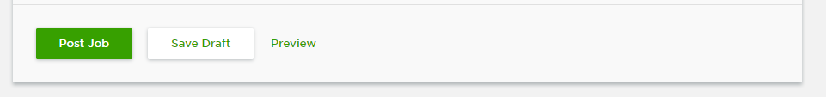
Client - Post a Job
Question 3: What roles do you need in the team?
Allow clients to select based Sub-Category
After this step, go to Post Job/Preview/Save Draft

Slide 24
Category/Sub Category

Slide 25
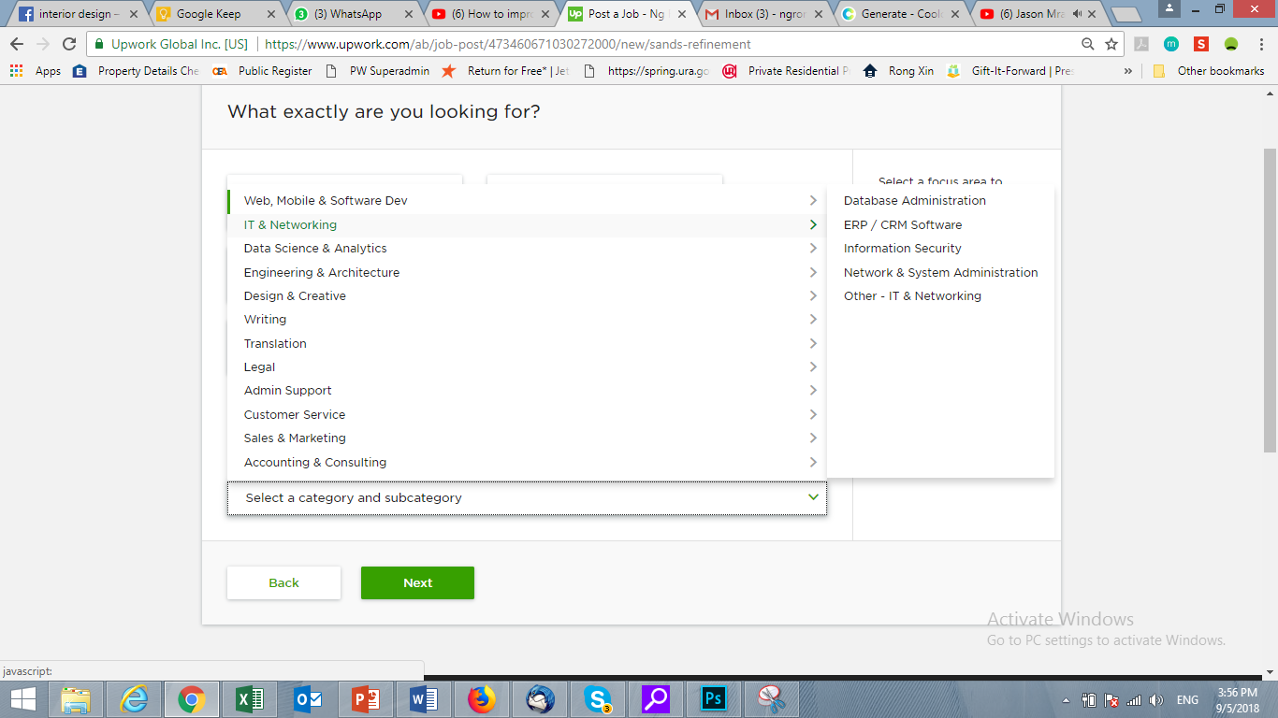
Category & sub-category

Slide 26
Category & sub-category

Slide 27
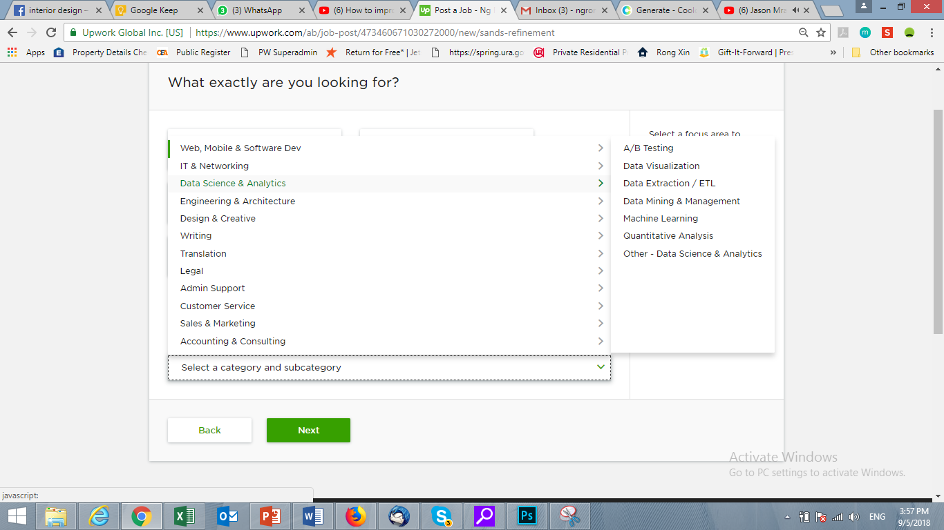
Category & sub-category

Slide 28
Category & sub-category

Slide 29
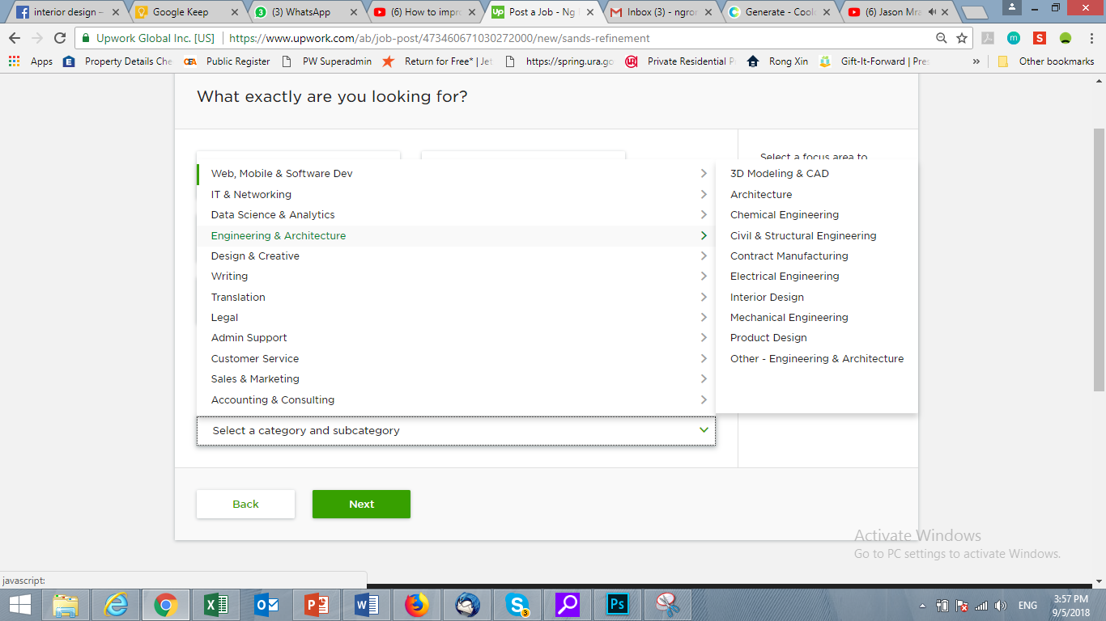
Category & sub-category

Slide 30
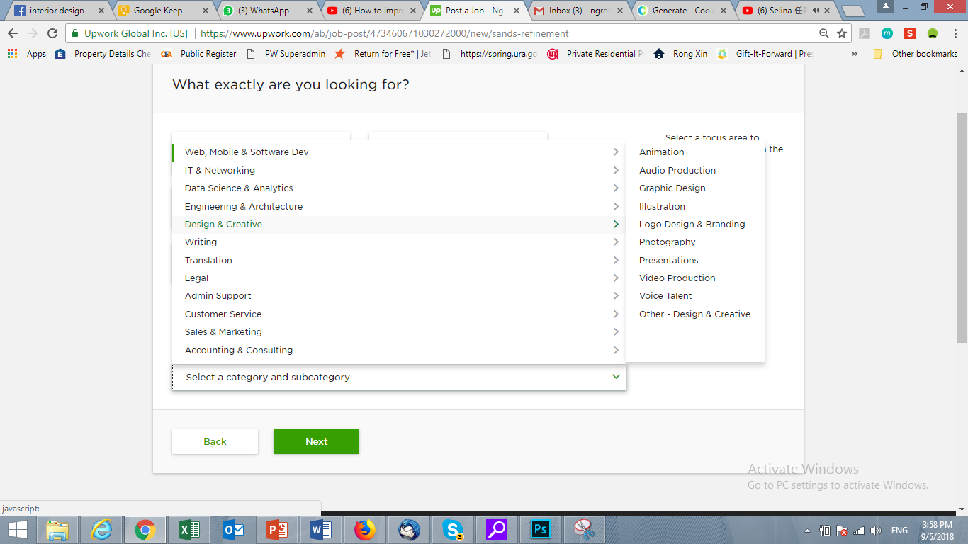
Category & sub-category

Slide 31
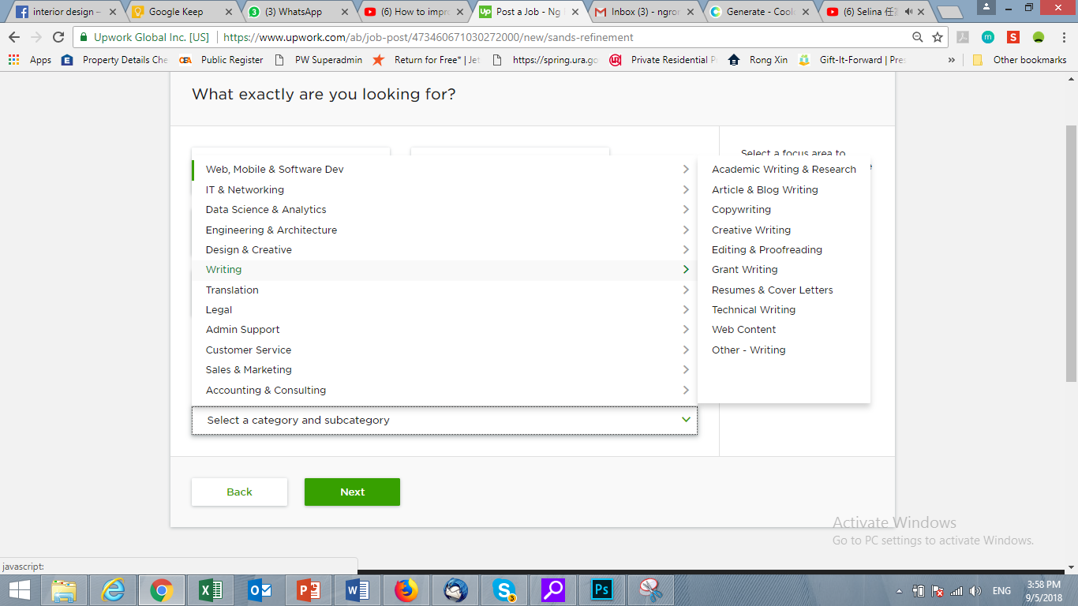
Category & sub-category

Slide 32
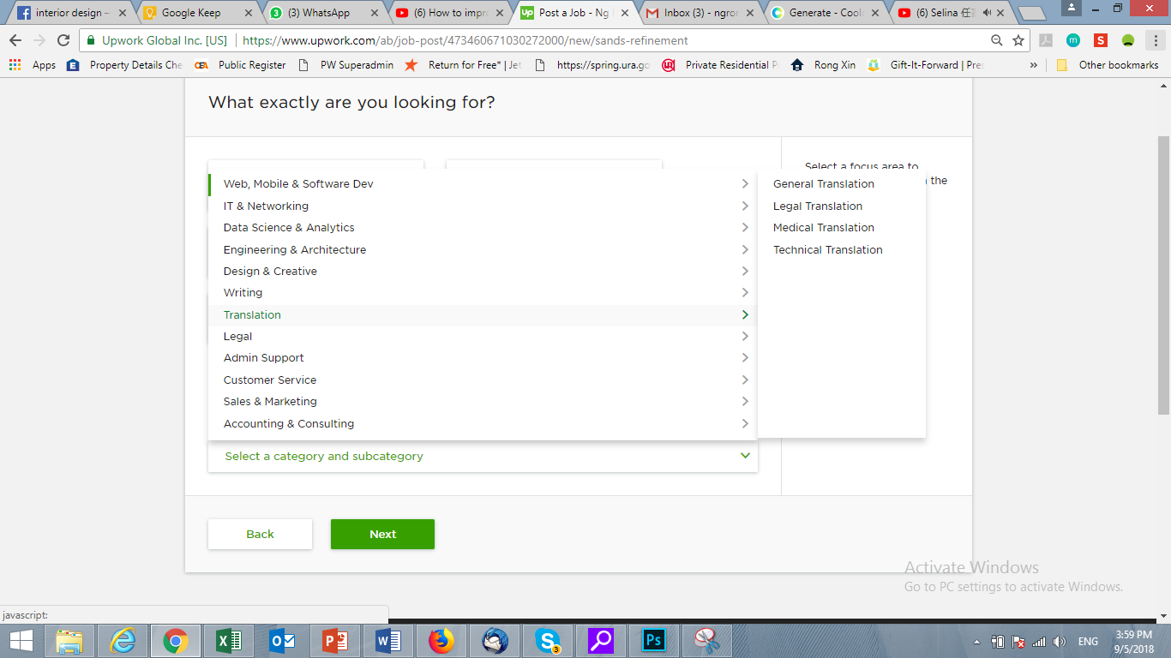
Category & sub-category

Slide 33
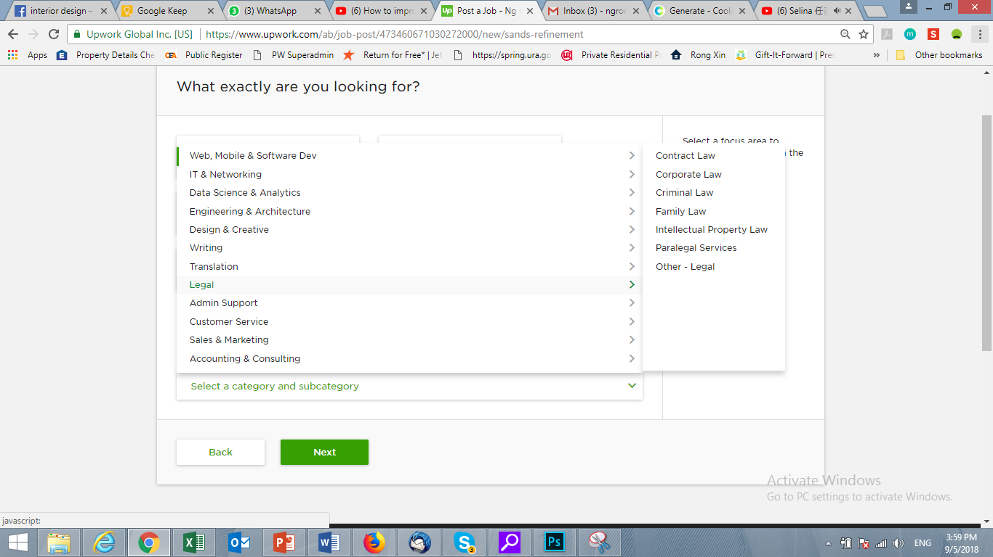
Category & sub-category

Slide 34
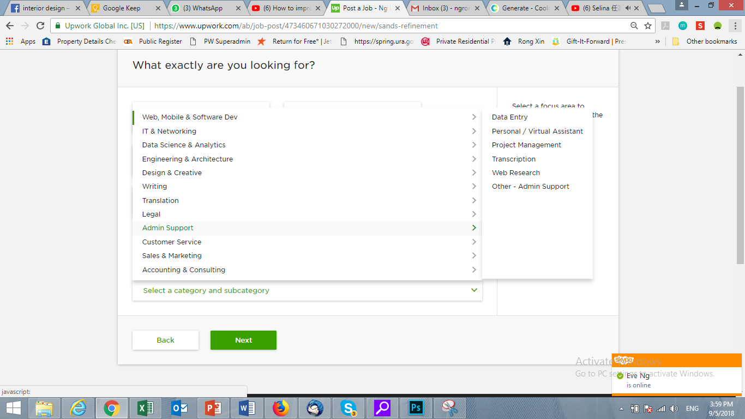
Category & sub-category

Slide 35
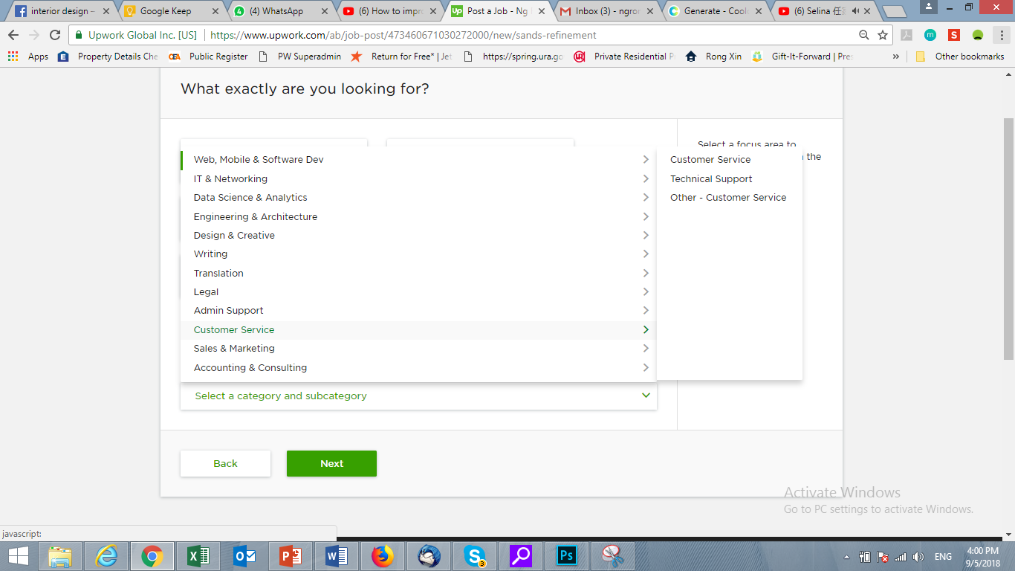
Category & sub-category

Slide 36
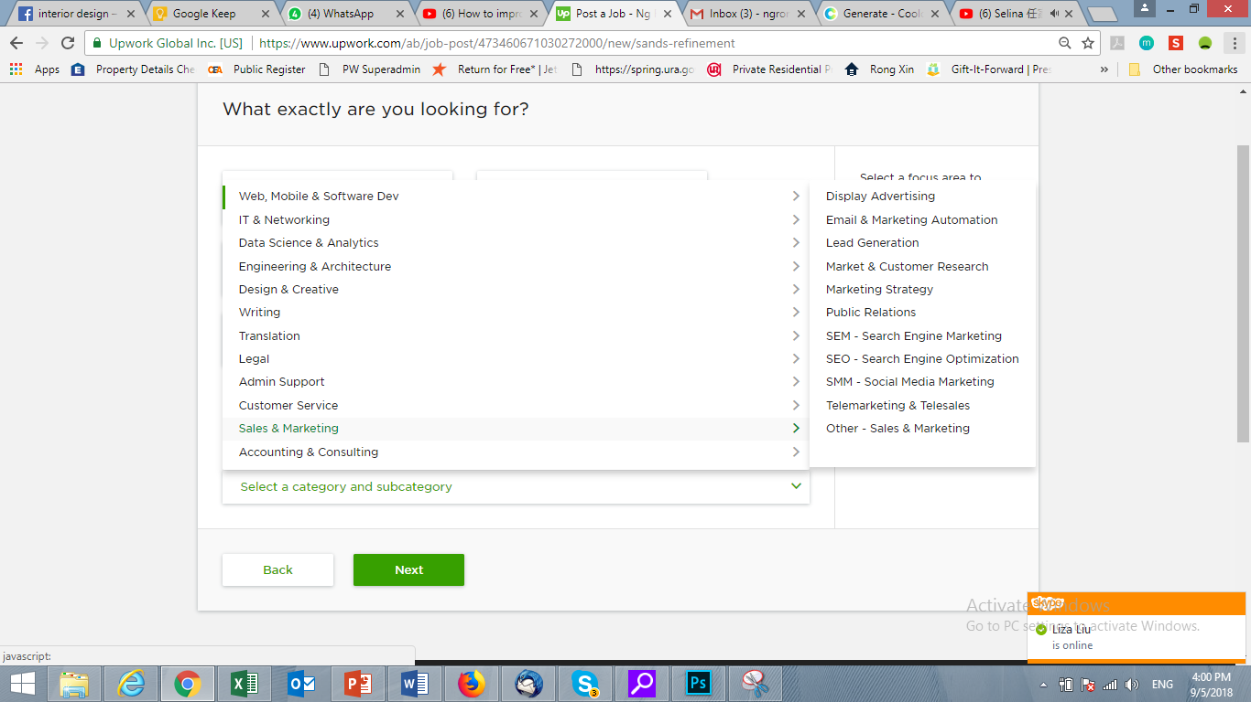
Category & sub-category

Slide 37
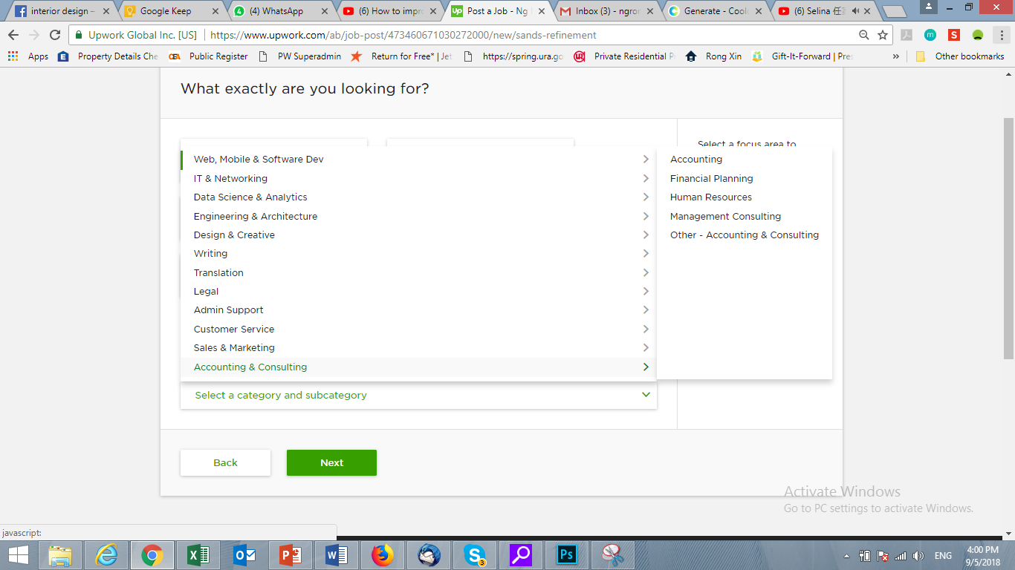
Category & sub-category

Slide 38
Skills
Tag to Categories
(To be updated again)

Slide 39
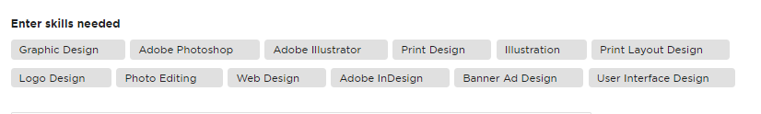
Category | Skills

Slide 40
Privacy Policy - https://www.upwork.com/legal#privacy User Agreement - https://www.upwork.com/legal#updated-user-agreement Terms of use - https://www.upwork.com/legal#

